Slide 1
Theory of Computation
Technical Presentation
Questions 1–5 Overview
PRESENTED BY:
K Gayathri
Reg:192311448

Slide 2
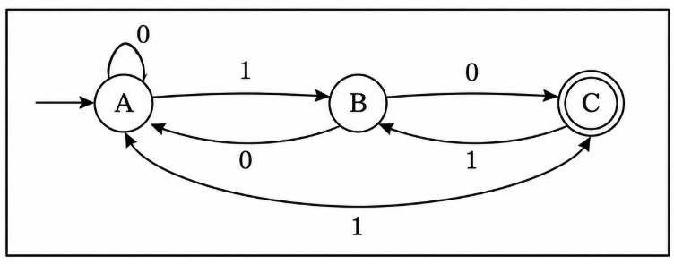
Question 1: NFA to DFA
NFA allows multiple transitions.
DFA has exactly one transition per symbol.
Use subset construction.
Steps: start state, compute state subsets, mark final states.
Challenge: state explosion (up to 2^n states).

Slide 3
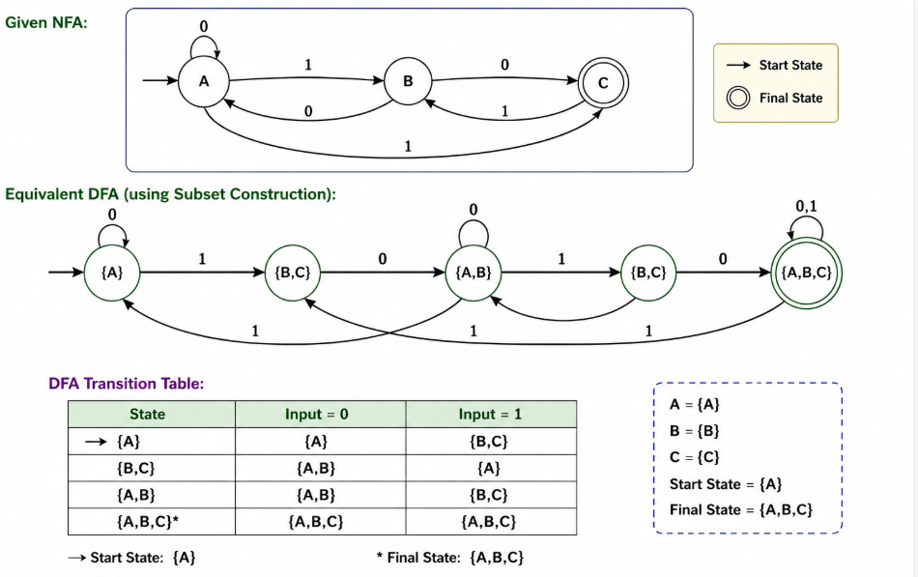
NFA TO DFA

Slide 4
Question 2: Mathematical Induction
Used to prove statements for all positive integers.
Base Case: verify n=1.
Induction Hypothesis: assume true for n=k.
Induction Step: prove for k+1.
Hence statement is true for all n.

Slide 5
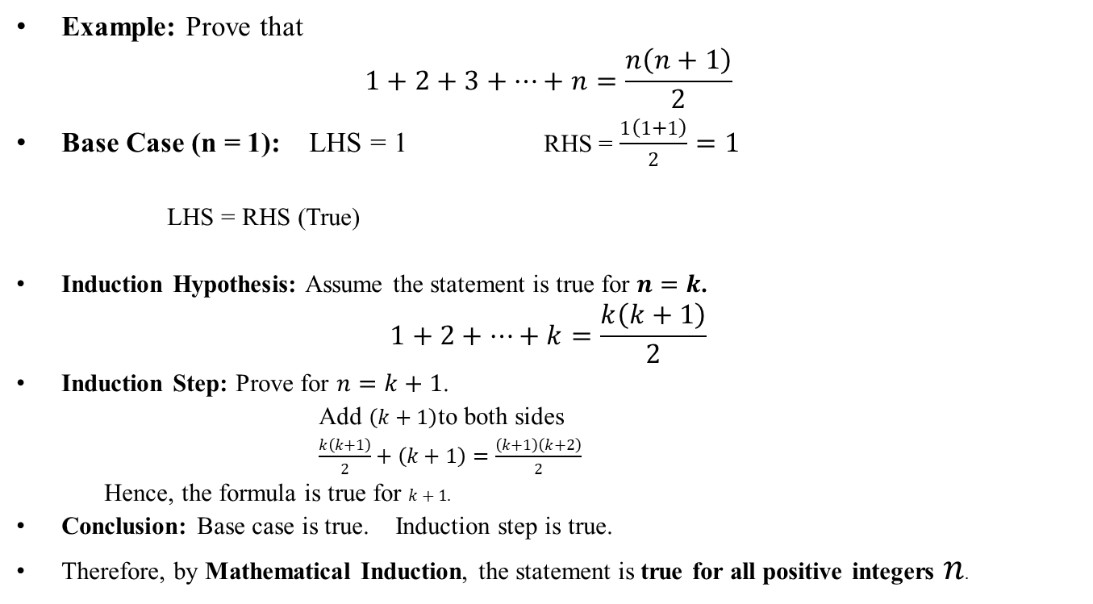
EXAMPLE
Example: Prove that
$$1+2+3+⋯+n=\frac{n\left(n+1\right)}{2}$$
Base Case (n = 1): LHS = 1 RHS = $\frac{1\left(1+1\right)}{2}=1$
LHS = RHS (True)
Induction Hypothesis: Assume the statement is true for $n=k$.
$$1+2+⋯+k=\frac{k\left(k+1\right)}{2}$$
Induction Step: Prove for $n=k+1$.
Add $\left(k+1\right)$to both sides
$\frac{k\left(k+1\right)}{2}+\left(k+1\right)=\frac{\left(k+1\right)\left(k+2\right)}{2}$
Hence, the formula is true for $k+1$.
Conclusion: Base case is true. Induction step is true.
Therefore, by Mathematical Induction, the statement is true for all positive integers $n$.

Slide 6
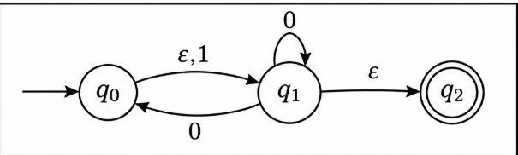
Question 3: ε-NFA to NFA
ε-transitions consume no input.
Compute ε-closure for every state.
Replace ε-moves with direct transitions.
Mark final states if ε-closure reaches a final state.
Remove all ε-transitions.

Slide 7
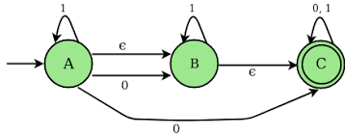
Question 4: ε-NFA to DFA
Find ε-closures.
Create DFA states as sets of NFA states.
Compute transitions for 0 and 1.
Mark DFA accepting states.
DFA recognizes same language.

Slide 8
Question 5: Key Comparison
DFA: deterministic.
NFA: multiple choices.
ε-NFA: includes ε-transitions.
All three accept regular languages.
DFA is preferred for implementation.

Slide 9
Advantages & Applications
Lexical analysis.
Pattern matching.
Compiler design.
Network protocol verification.
Text searching.

Slide 10
Conclusion
NFA, ε-NFA and DFA are equivalent in power.
Conversions preserve the language.
Mathematical induction proves correctness.

Slide 11
THANK YOU

